Slide 1
Markov Chains

Slide 2
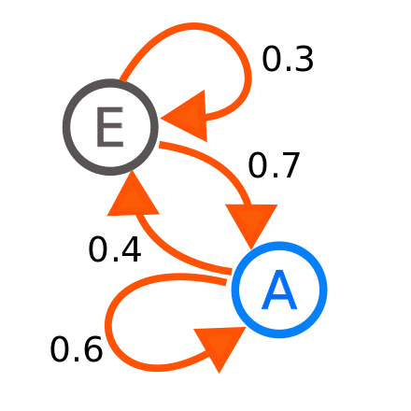
What are Markov Chains?
A Markov Chain is a mathematical system that experiences transitions from one state to another according to probabilistic rules.

Slide 3


Real life example #1 (Reddit)
There is a subreddit simulator where a bot generates meaningful comments, through use of GPT3 and Markov Chains. The simulator pulls in a significant chunk of all the comments and titles within each community that uses the word for word probabilities to build titles and comments from scratch.

Slide 4

Real life example #2 (Election Polls)
In 2016, markov chains were used to forecast the elections, which was characterized as a random process, and the knowledge of prior election outcomes to create probabilities and used to forecast elections in similar incremental approaches.

Slide 5
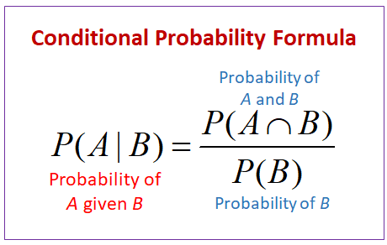
Conditional Probability

Slide 6
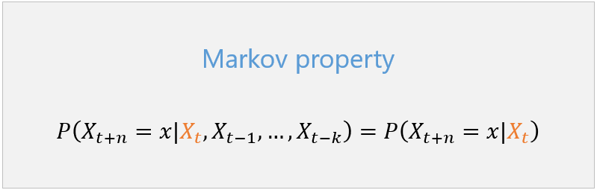
Mathematical Definition of Markov Chains
A stochastic process with the property that, given the value of X_{t}, the values of X_{s} for s>t are not influenced by the values of X_{u} for u<t.
As seen with this formula there is the Markov property

Slide 7

Markov Property
The future is independent of the past, conditioned on the present.

Slide 8

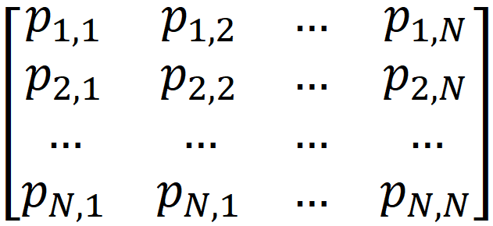
Probability transition matrix
The probability of X_{n+1} being in state j given that X_{n} is in state i is called the one-step transition probability.

Slide 9
Example of Markov Property

Slide 10
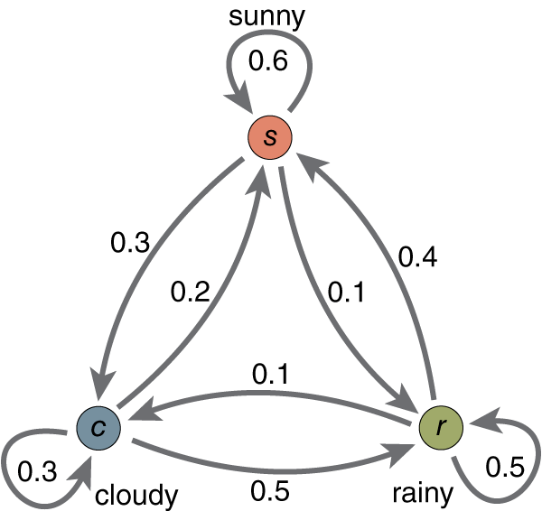
Practice problem
What’s the corresponding transition matrix?
Notes:
Ashwin

Slide 11
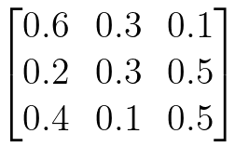
Practice problem
What’s the corresponding transition matrix?
Notes:
Ashwin

Slide 12
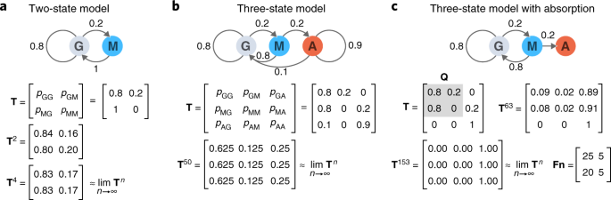
Practice problem 2
What’s the corresponding Markov Chain?
Notes:
Ashwin

Slide 13
Practice problem 2
What’s the corresponding Markov Chain?
Notes:
Ashwin

Slide 14
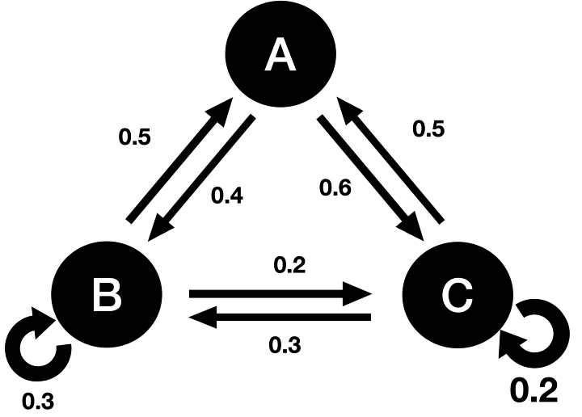
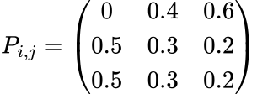
Multi-Step Transition Matrix
How can we represent jumping multiple steps at a time?
Notes:
Ashwin

Slide 15

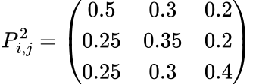
Multi-Step Transition Matrix
How can we represent jumping multiple steps at a time?
Notes:
Ashwin

Slide 16
What kinds of questions can you solve with MCs?
A lot of our functionals of markov chains are used using first step analysis.
The methods we break it down by considering the first transition, and invoking the law of total probability coupled with the Markov property to establish characteristic relationships among the unknown variables.

Slide 17
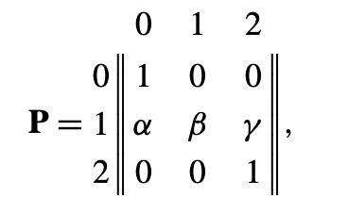
First example
First consider, the following transition matrix
Set T = min{n>=0; X_{n}=0 or X_{n}=2}
In this first example, we will be considering
u=Pr{X_{T}=0 | X_{0}=1}

Slide 18
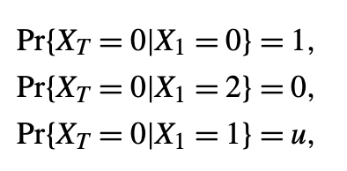
Answer

Slide 19
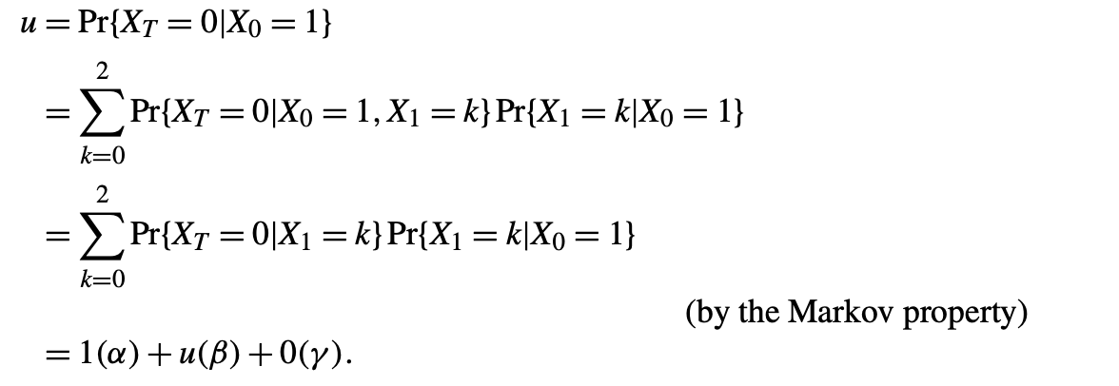
Answer cont.

Slide 20

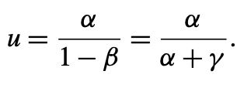
Answer cont.
We obtain the equation
Which gives,

Slide 21
Second example
We will use the same probability transition matrix as above, but we will find
v=E[T|X_{0}=1]

Slide 22
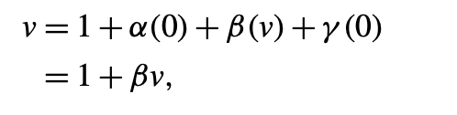
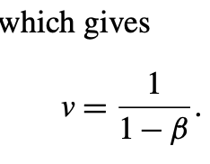
Answers cont.
Using first step analysis

Slide 23
Thank you!!

Slide 24
You’re welcome

